Slide 1


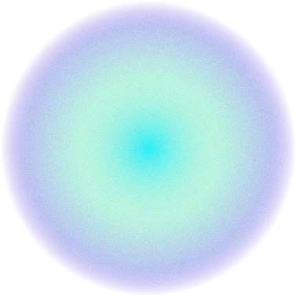
CWM CFD Presentation
Claudio Vestini – May 2024

Slide 2
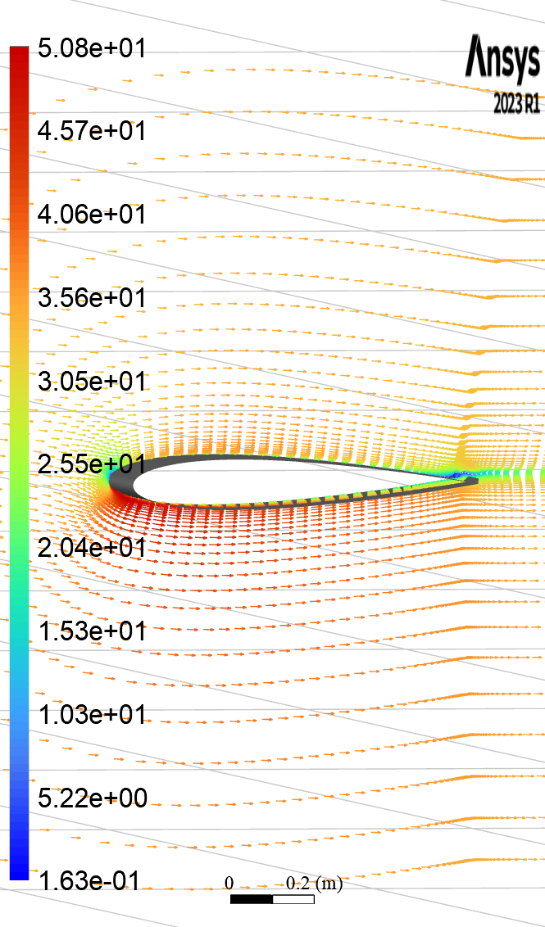
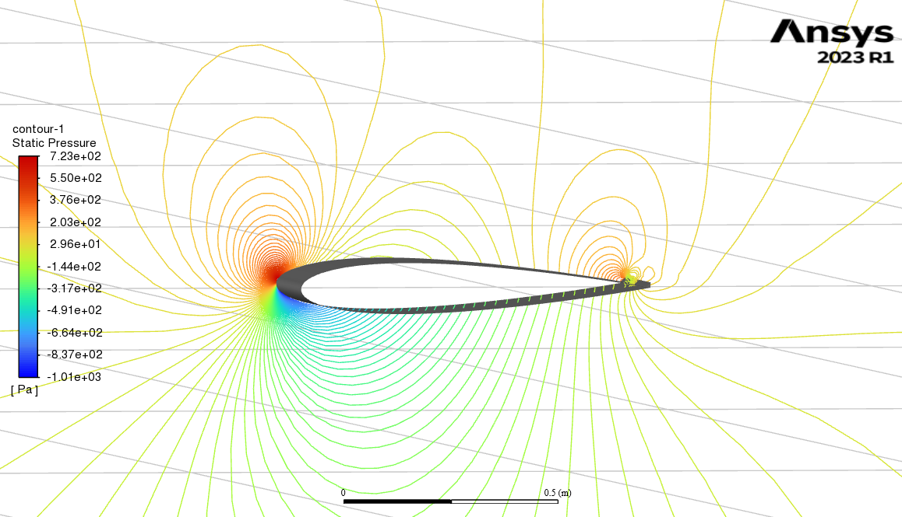
Introduction
Analysis of a NACA0012 aerofoil using CFD schemes, involving:
Method of finite volumes in Ansys Fluent
Implicit formulation
Second-order upwind discretisation
Addition of a Gurney Flap

Slide 3
01.
Inviscid Model
Unmodified aerofoil
Analysis of model sensitivity to mesh topology (size and resolution)
Lift / Incidence characteristics

Slide 4
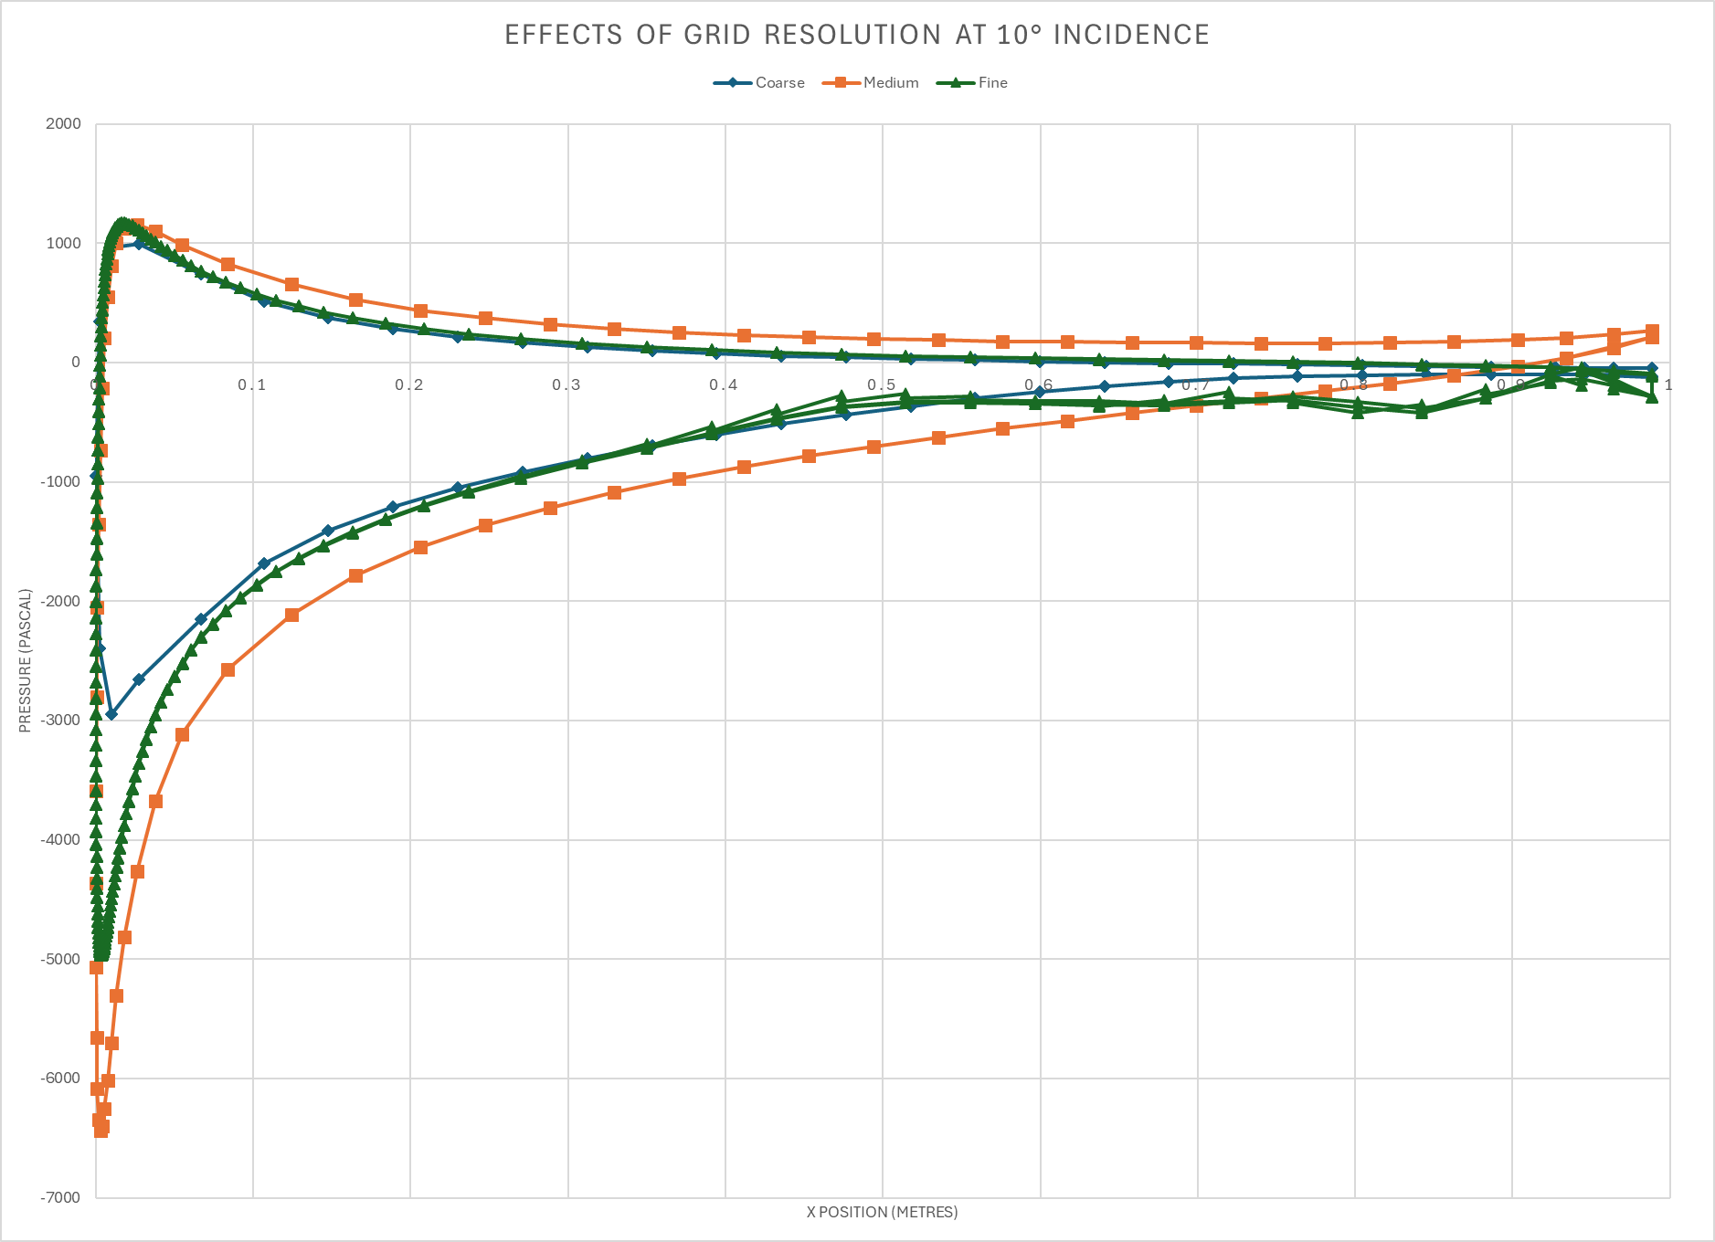
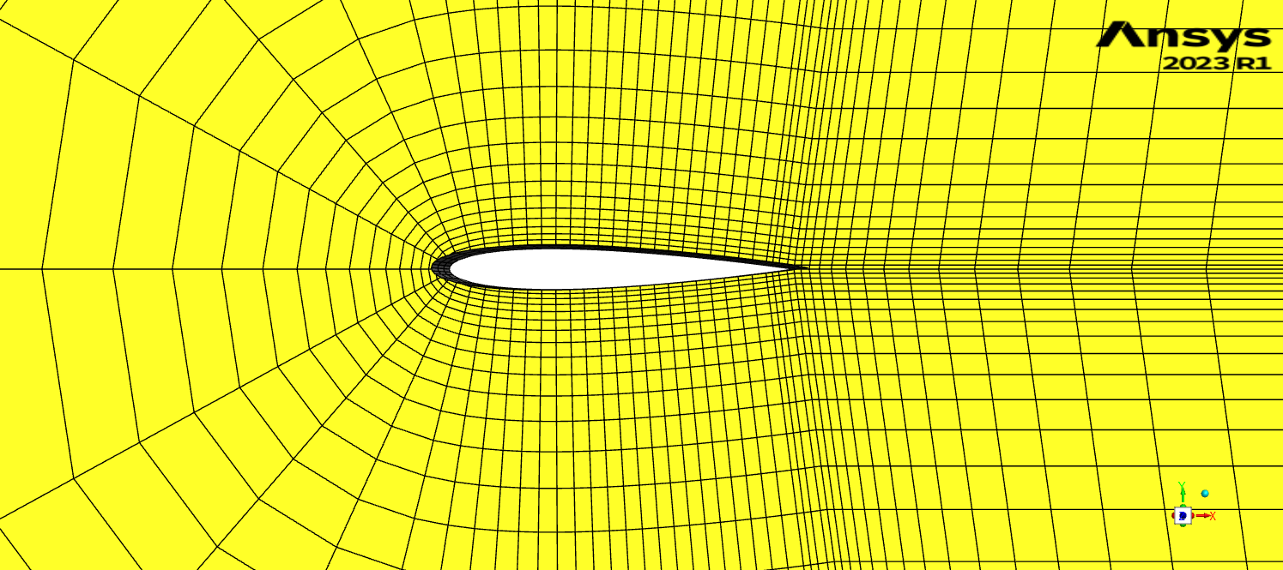
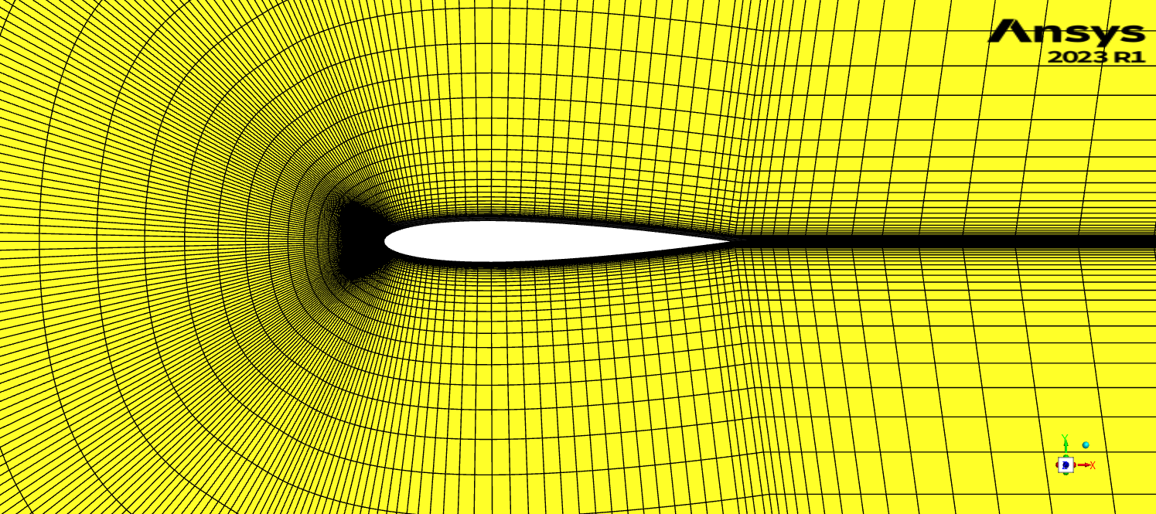
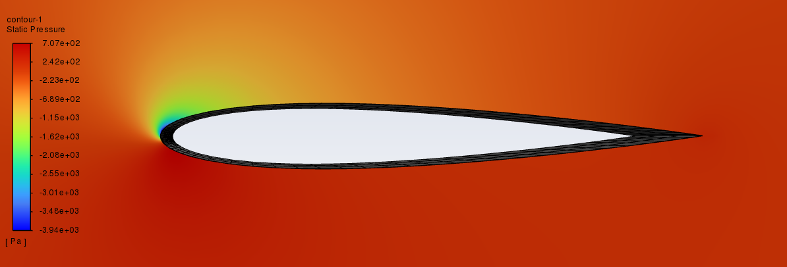
Mesh Resolution
Coarse Mesh (0.1x)
Underpredicts pressure distribution
Fine Mesh (10x)
10° Incidence
Can be expensive to run, better results

Slide 5
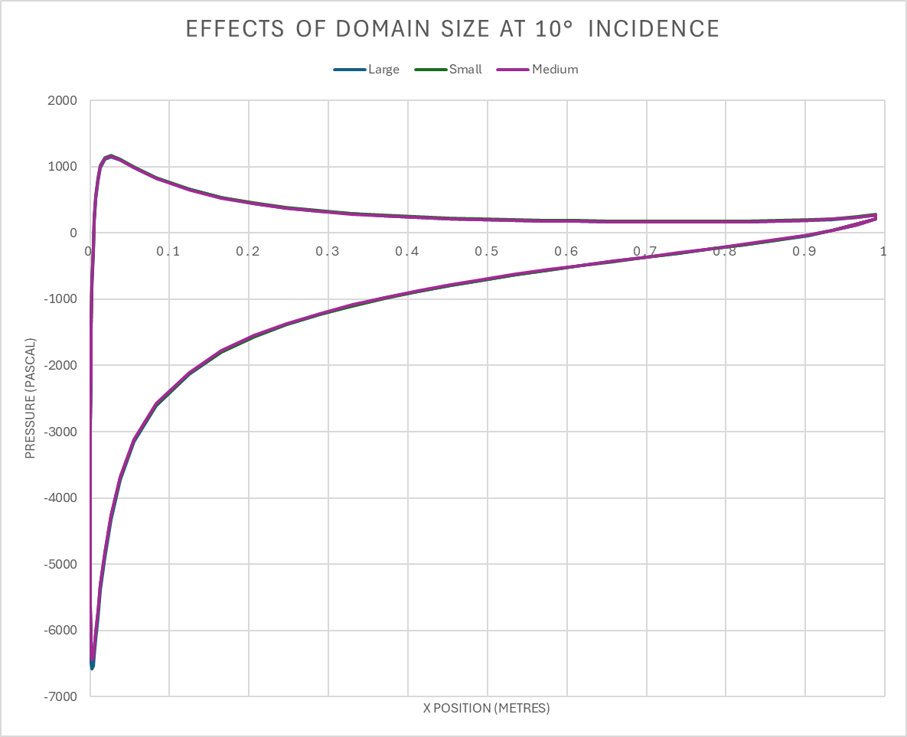
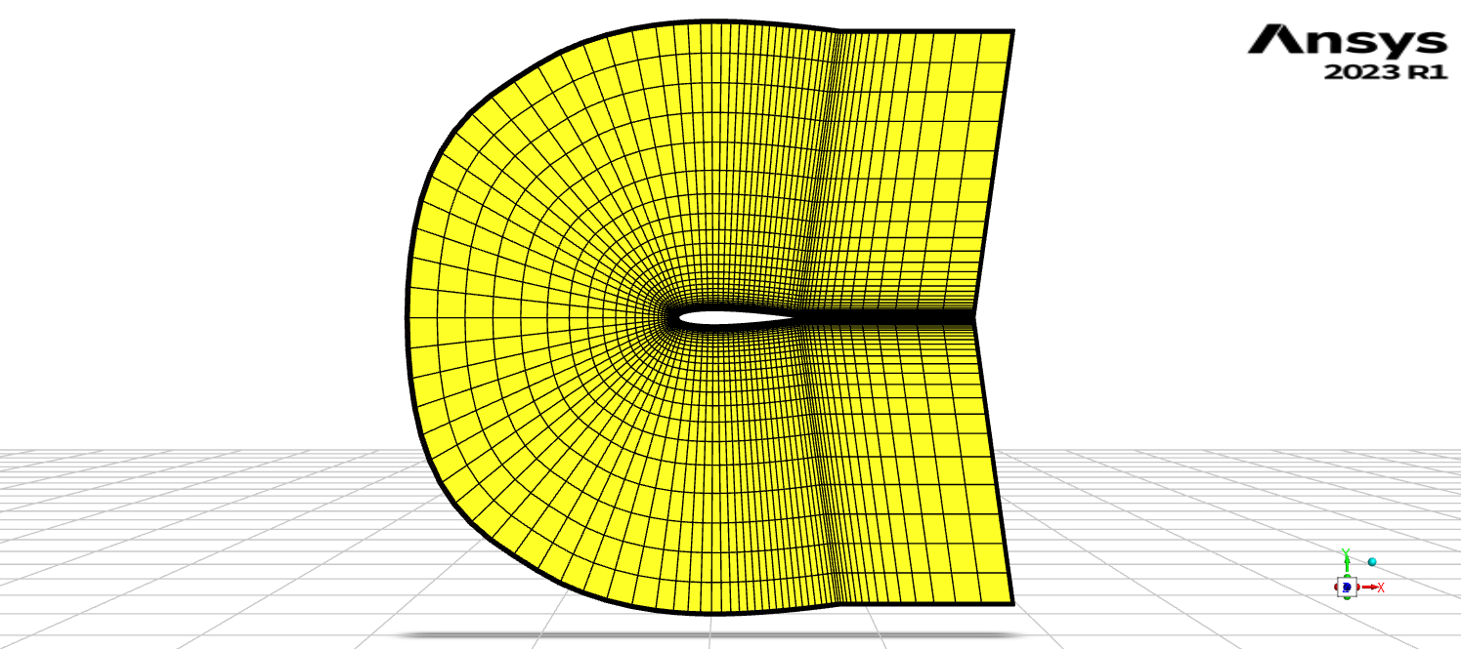
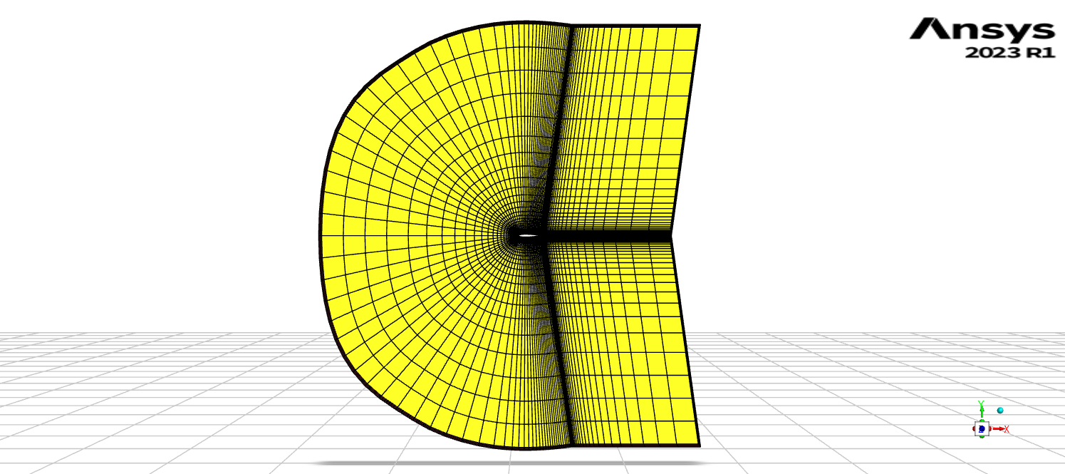
Domain Size
Small Domain (0.1x)
Large Domain (10x)
10° Incidence
Not much difference…

Slide 6
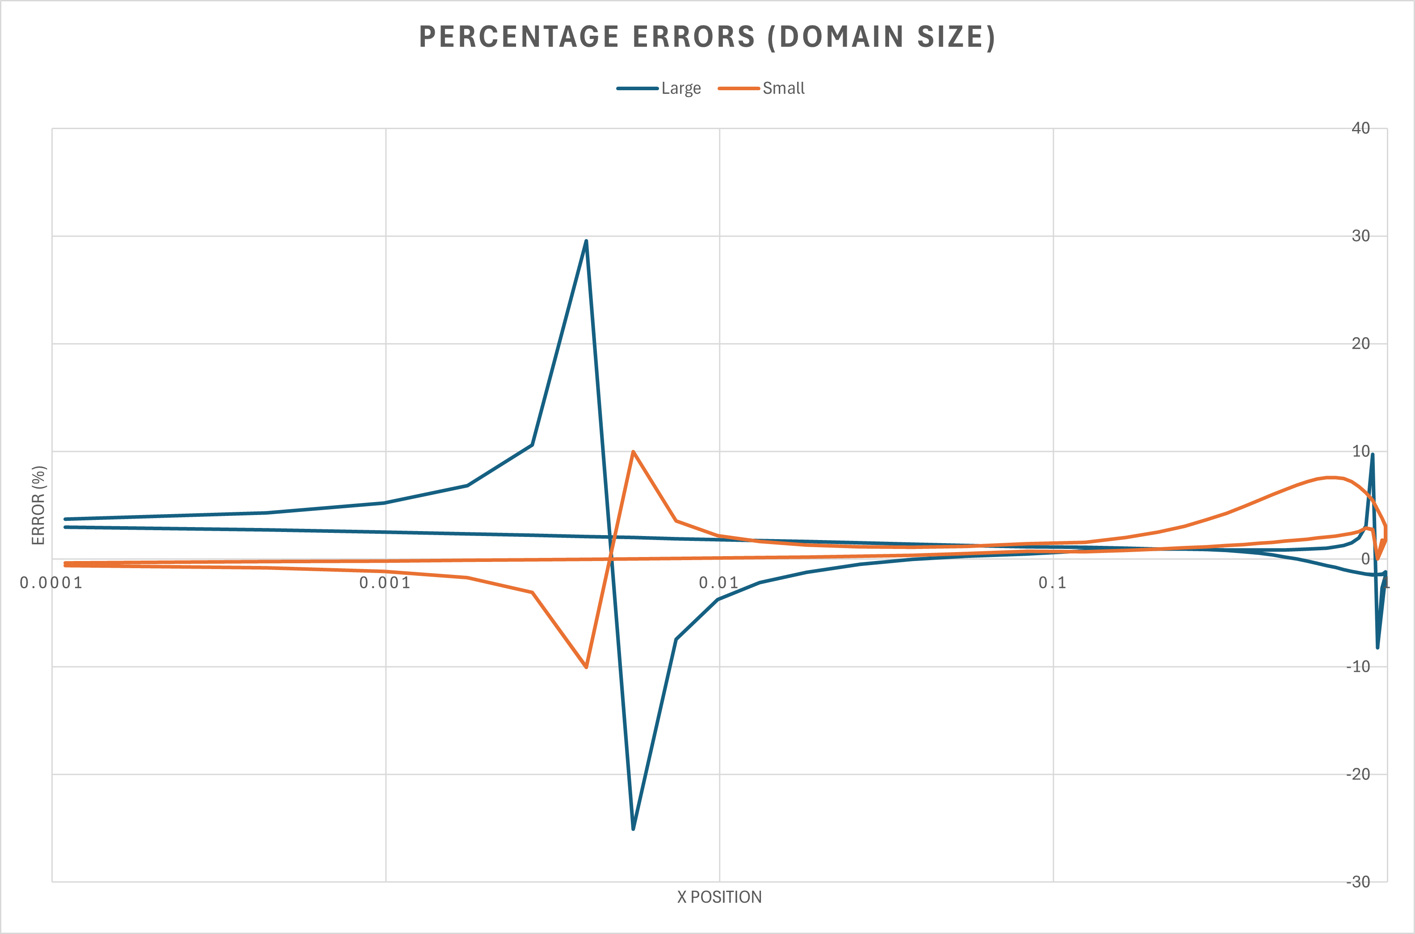
Domain Size
…most sensitive zone is the stagnation point
Small domain gives a maximum 10% error
Large domain is 30% more accurate at predicting pressures around most critical point

Slide 7
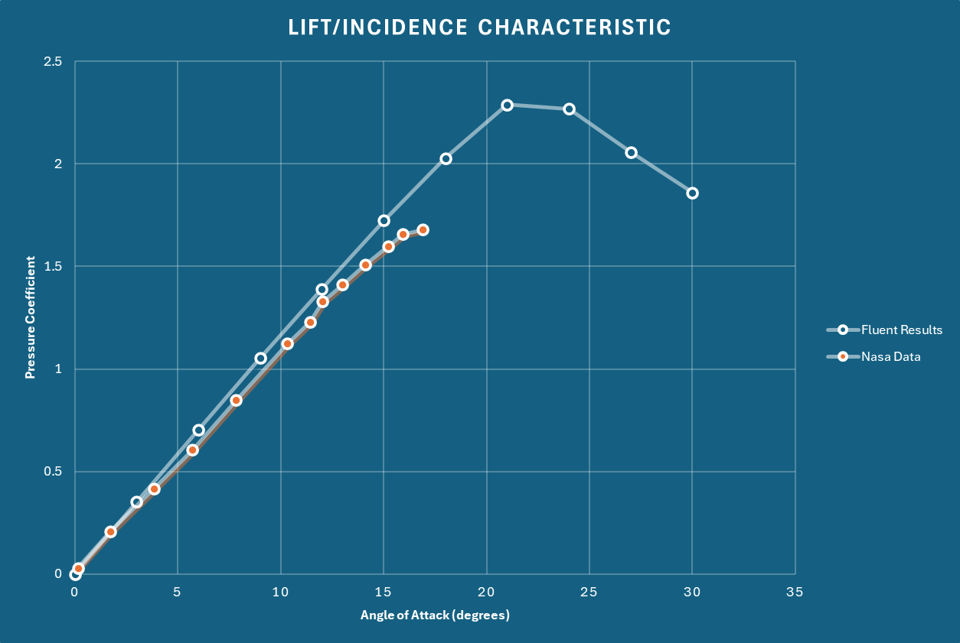
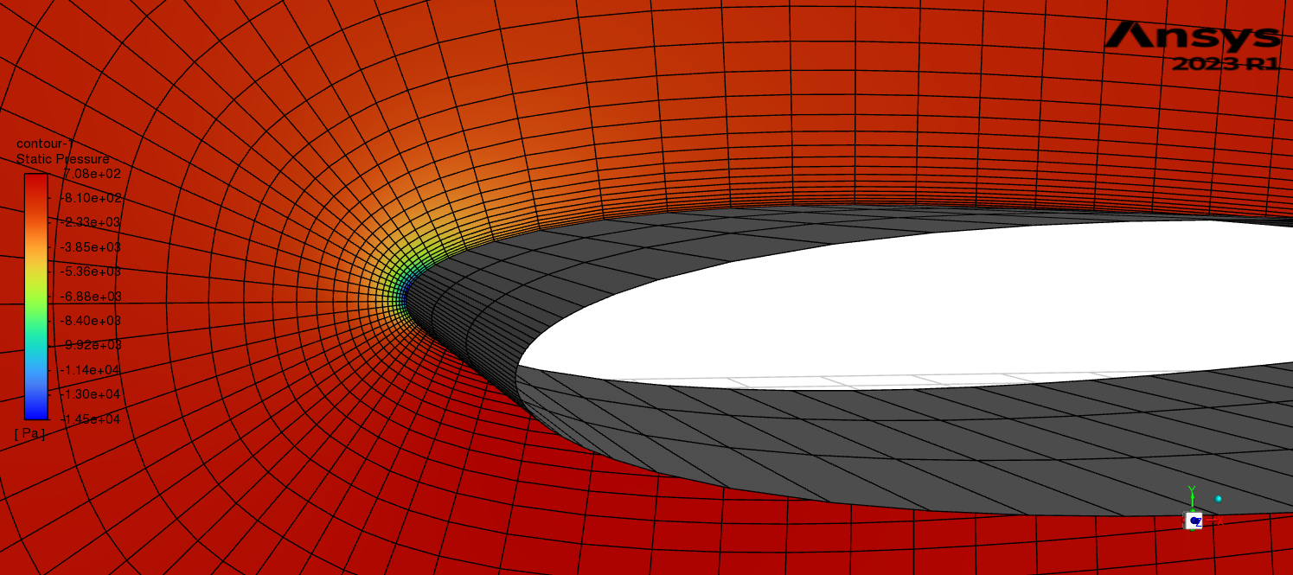
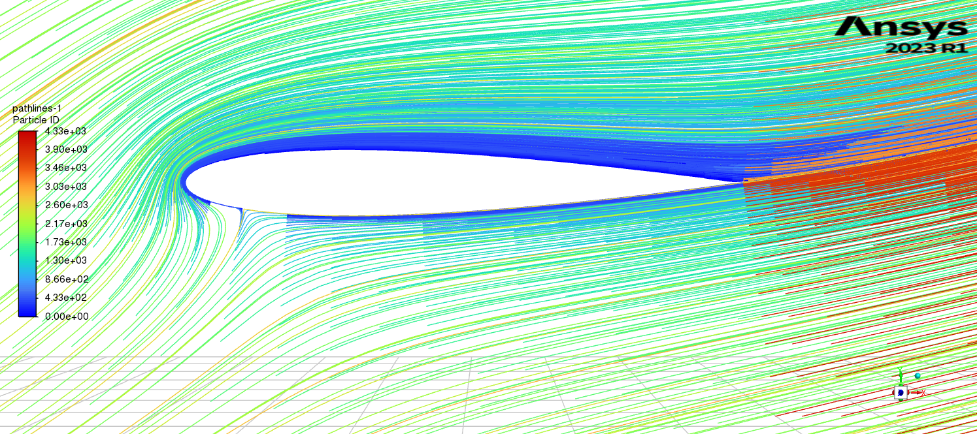
Lift / Incidence Characteristic
21° Incidence
The model predicts stalling for an inviscid run… Nonsense!

Slide 8
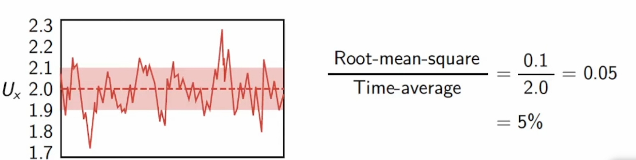
02.
Viscous Model
K – ω RANS Model, Intensity of 5%, length scale of 0.02
Unmodified Aerofoil
Model sensitivity, lift/drag polar

Slide 9
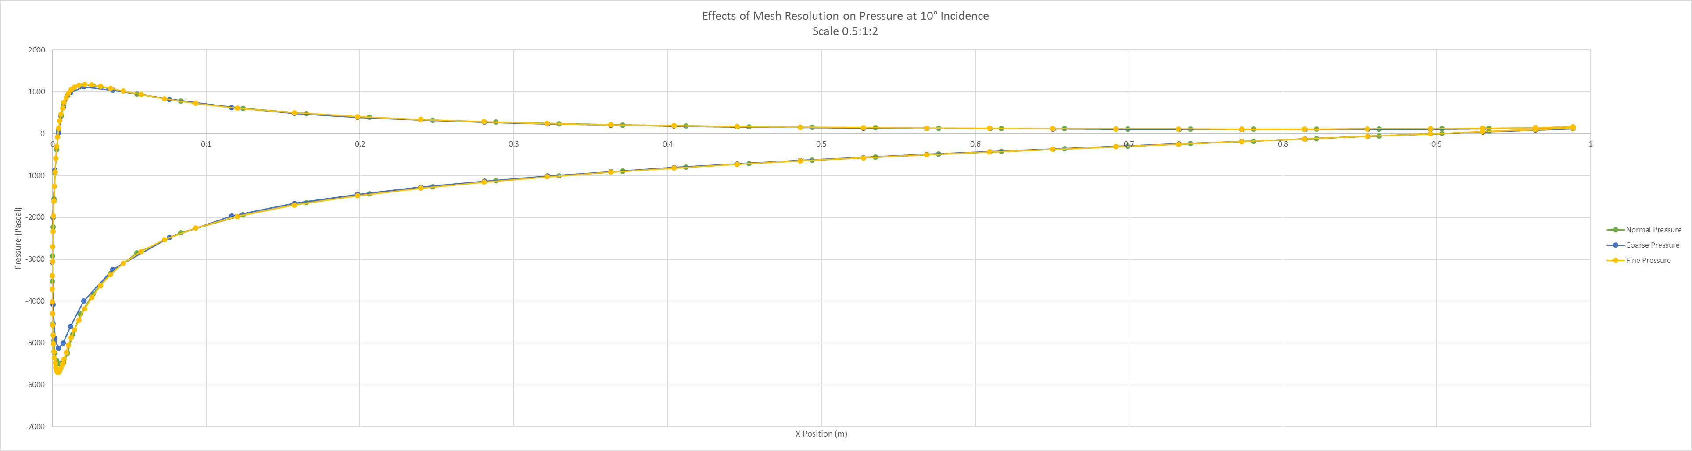
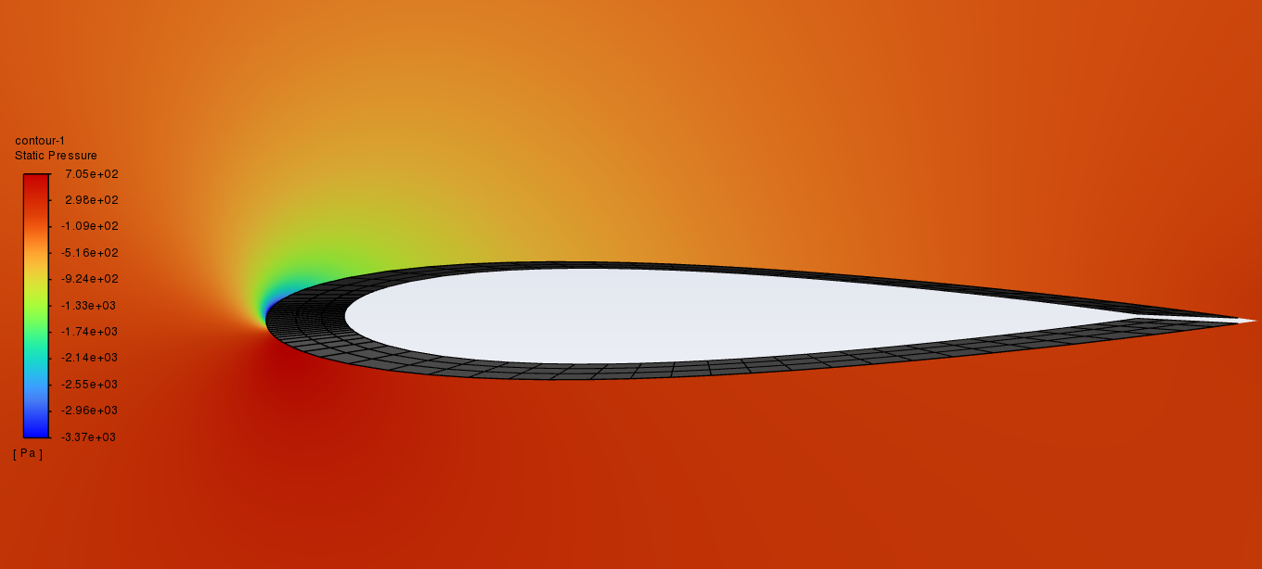
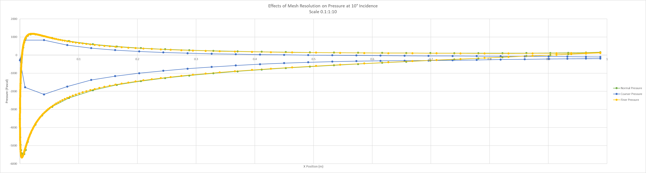
Mesh Resolution - Pressure
Not much change, most significant difference at top side around leading edge
10° Incidence
A 0.1:1 scale coarser mesh will produce unreliable results (although this is unlikely to be implemented)

Slide 10
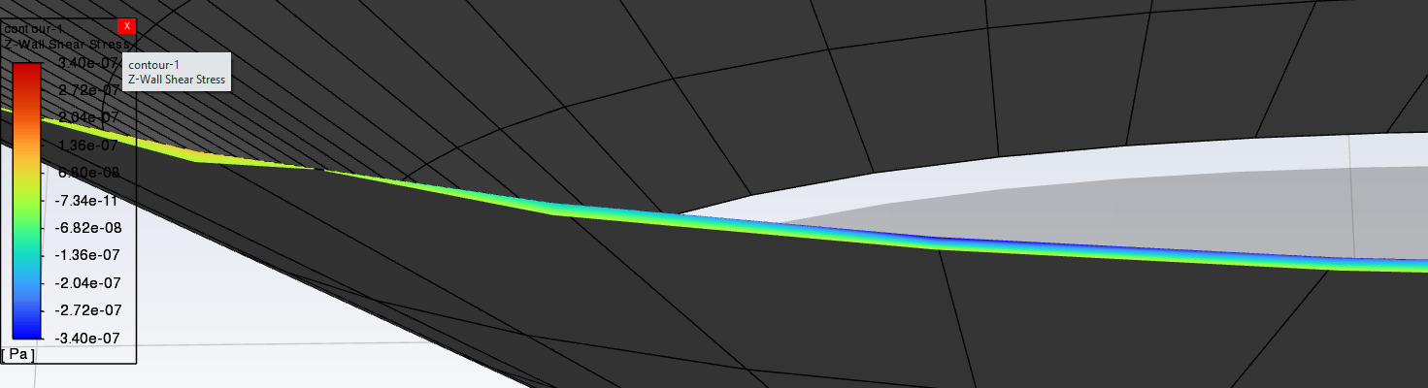
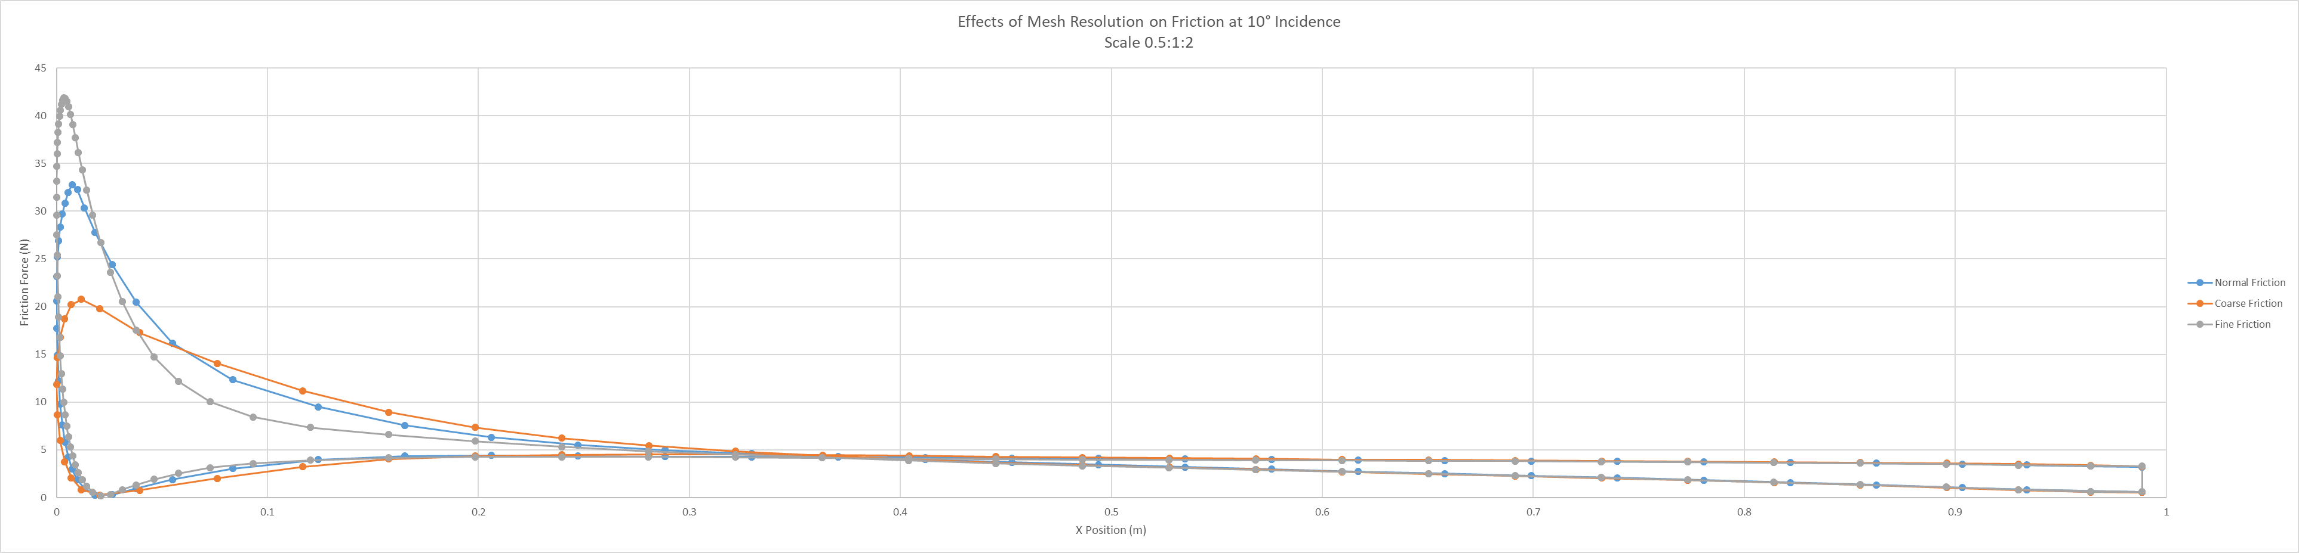
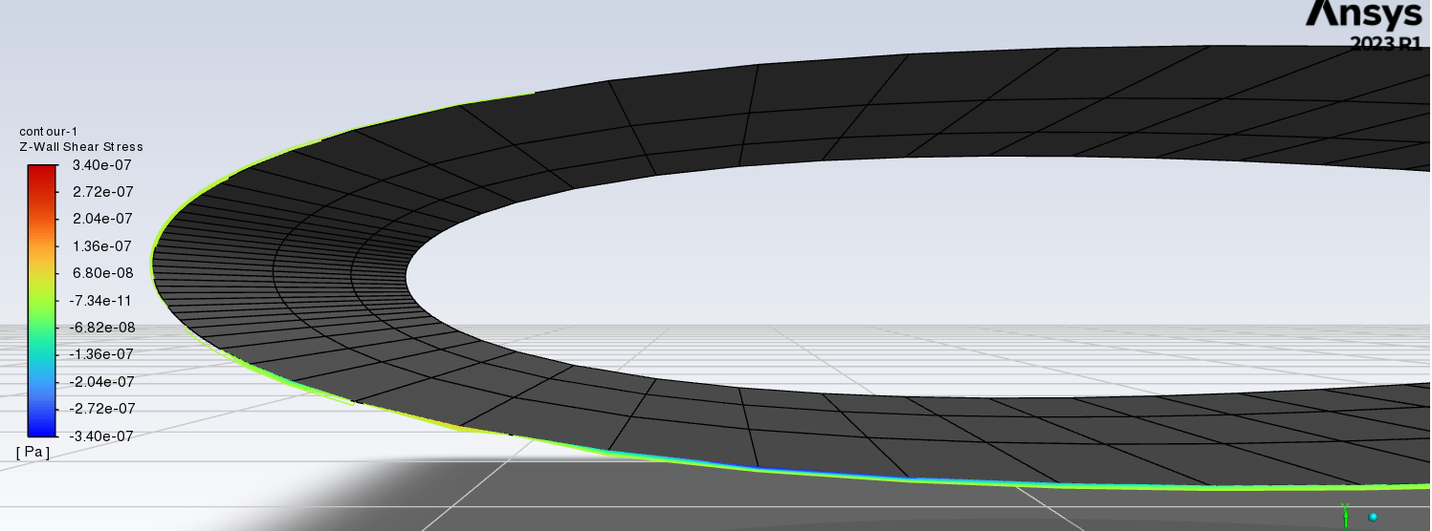
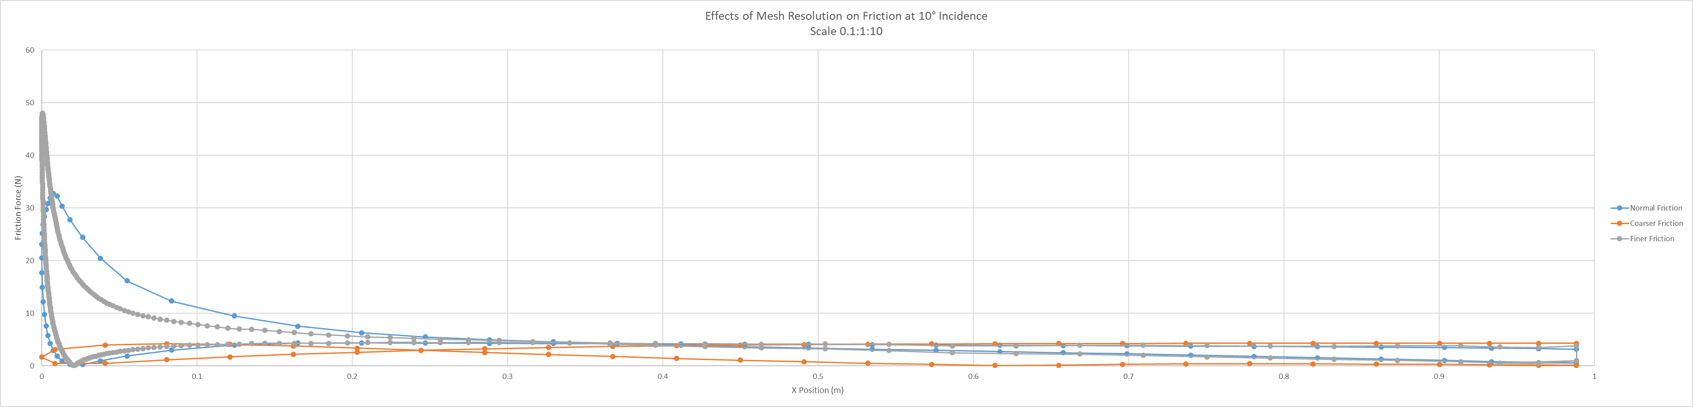
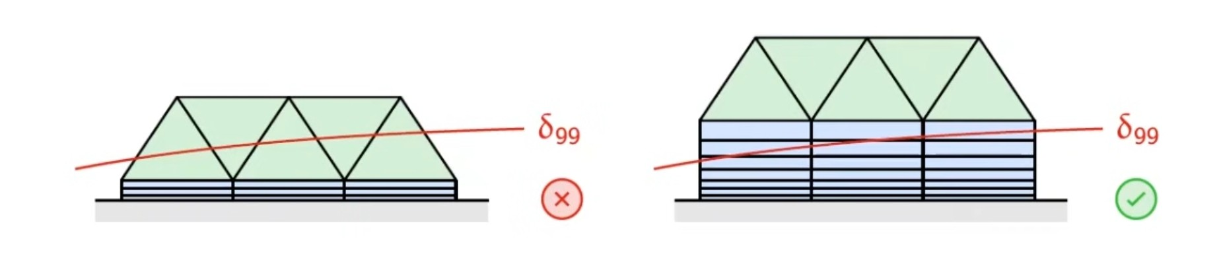
Mesh Resolution - Friction
Stagnation region experiences large du/dy
Friction is more sensitive than Pressure to mesh resolution
For a viscous run, a fine mesh is much more effective at predicting the effects of boundary layers on shear stresses

Slide 11
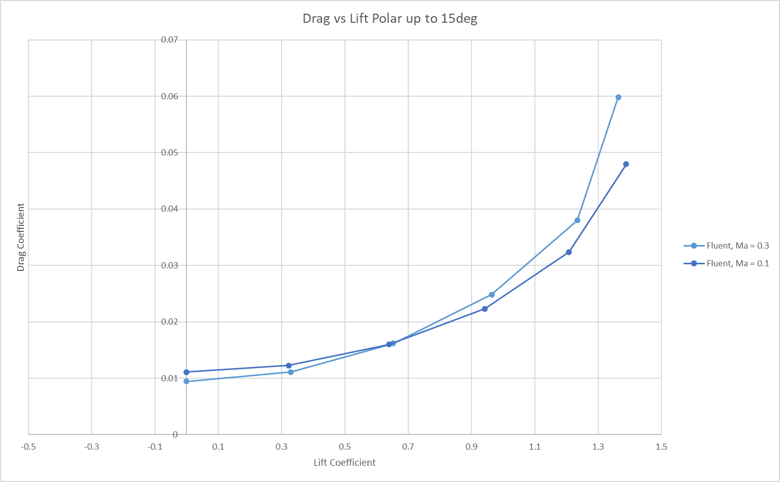
Lift / Drag Polar
Re = 6.6e6
Re = 2.2e6
The polar curve is virtually Reynolds-independent for fully-developed flow
Use Ma = 0.3 to match NASA data (at Re = 6e6) on next slide

Slide 12
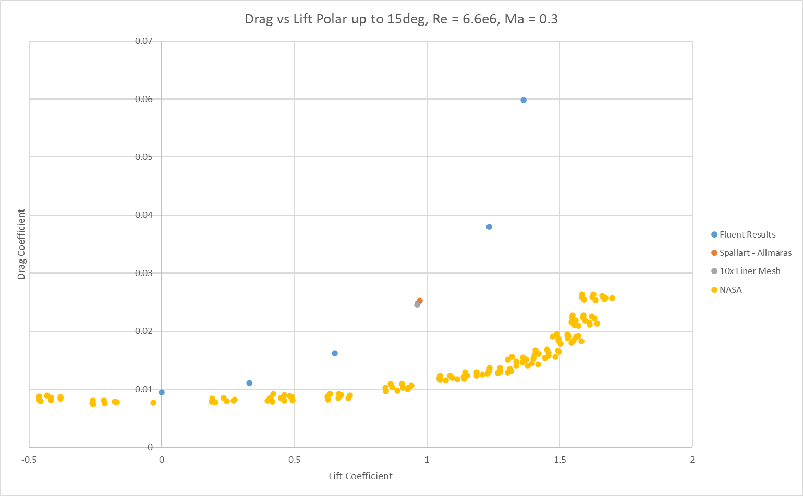
Lift / Drag Polar
9° Incidence
The Fluent results always predict a higher drag than NASA data
Likely due to numerical error in simulation

Slide 13
03.
Gurney Flap
Viscous K – ω Model
Analysis of flap performance at Low Incidence and High Incidence

Slide 14
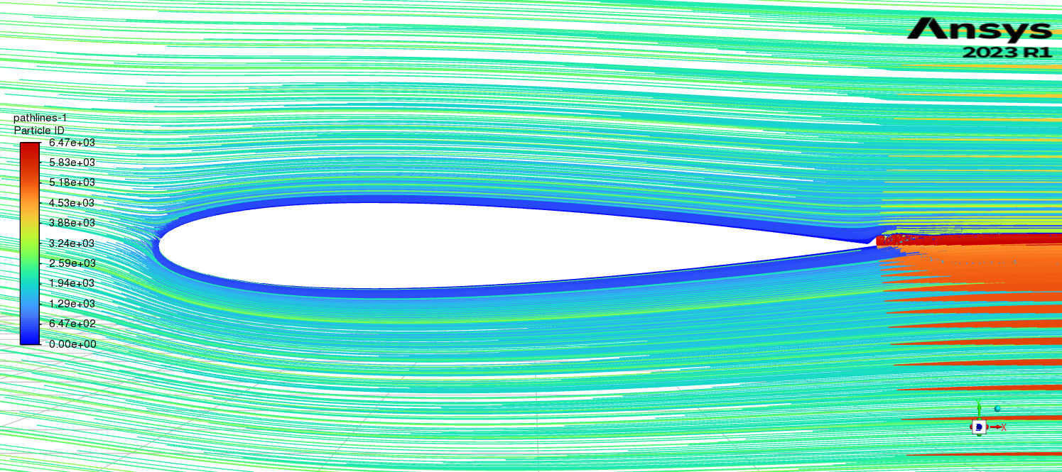
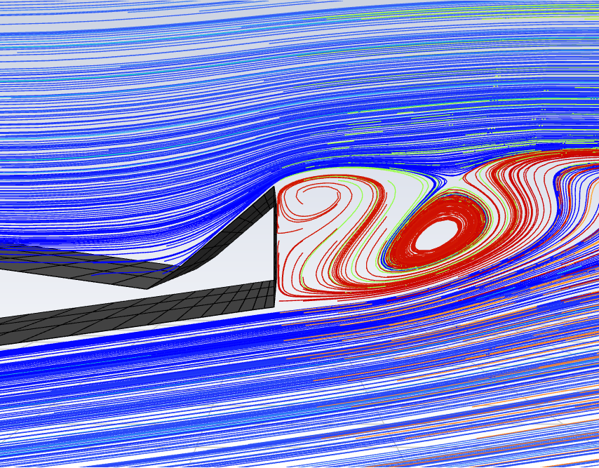
Low Incidence - Physics
Flap diverts streamlines upwards at the trailing edge, creating an updraft and a resultant downforce
This provides a nonzero (negative) lift at small angles of attack (including 0°)
View of the Flap
Incidence of -3°

Slide 15
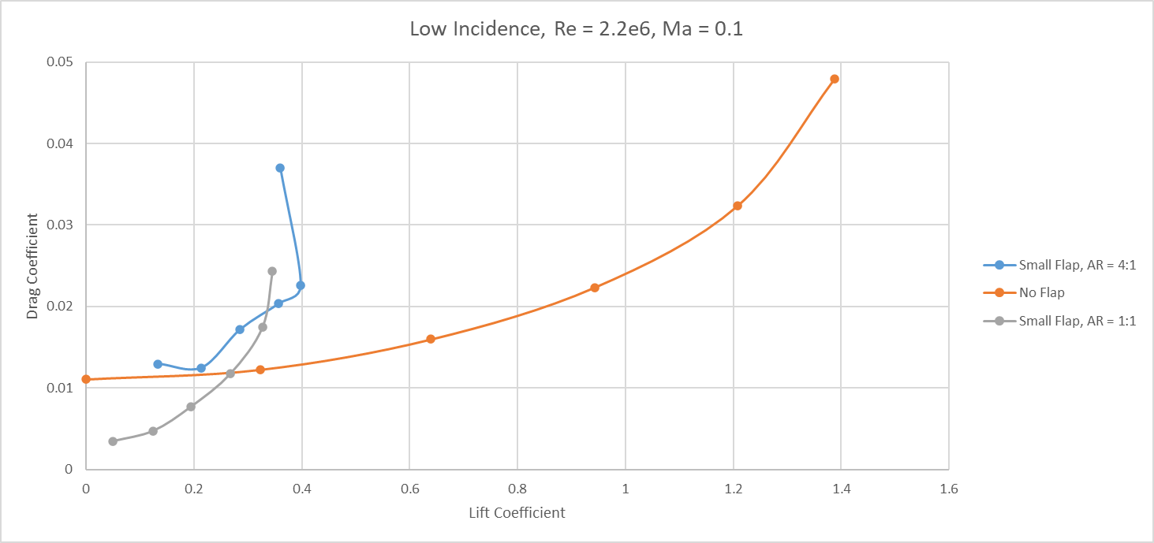
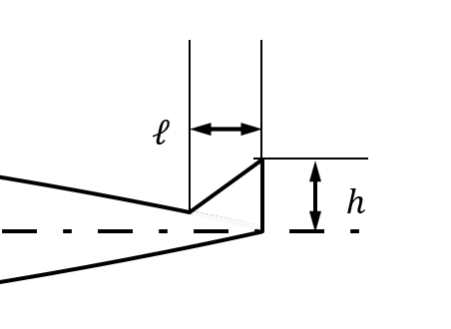
Low Incidence - Maths
A streamlined flap (aspect ratio of 1:1) produces extra lift at the expense of a small amount of drag – overall performance is better
A non-streamlined flap (high aspect ratio of 4:1) produces too much drag for a similar amount of lift – overall performance is worse
Aspect Ratio:
AR = h/l

Slide 16
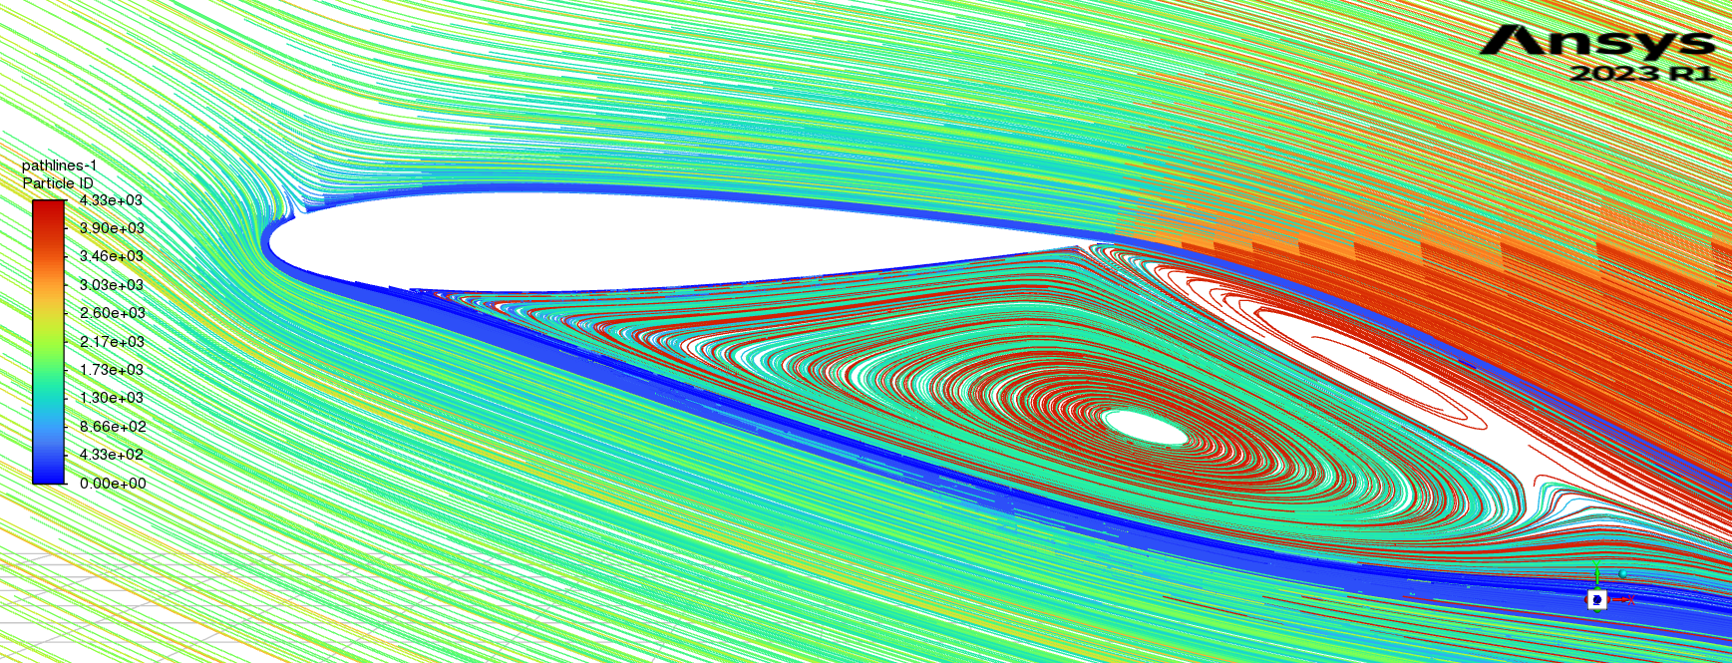
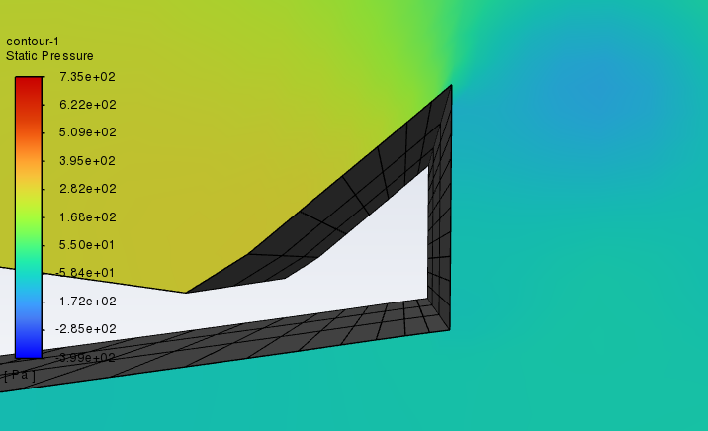
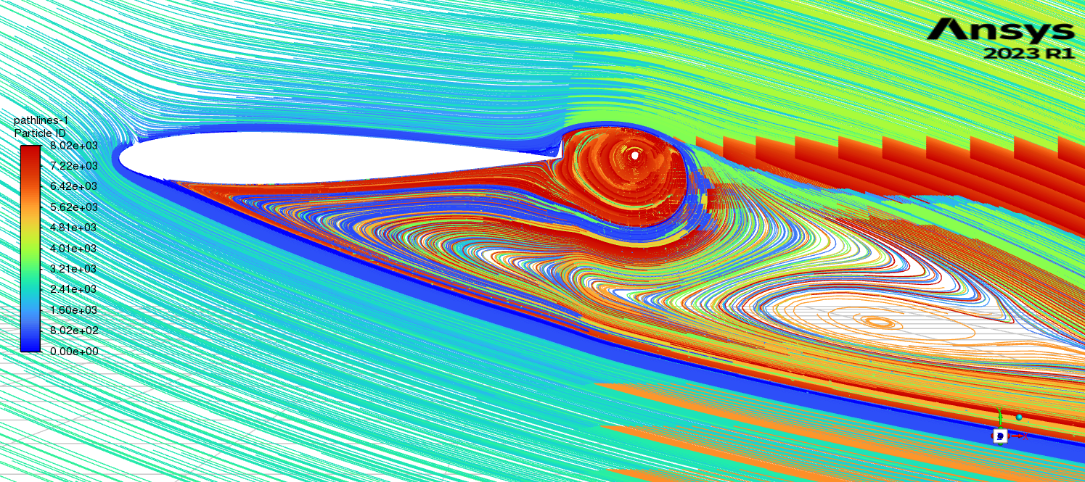
High Incidence - Physics
Flap has high pressure on the upstream side and low pressure on the downstream side
No flap
Flap
View of the Flap
This generates an additional net drag force in the direction of the streamlines
Comparing this to the no-flap aerofoil, it will experience a smaller drag force
Incidence of -20°, Re = 3e5

Slide 17
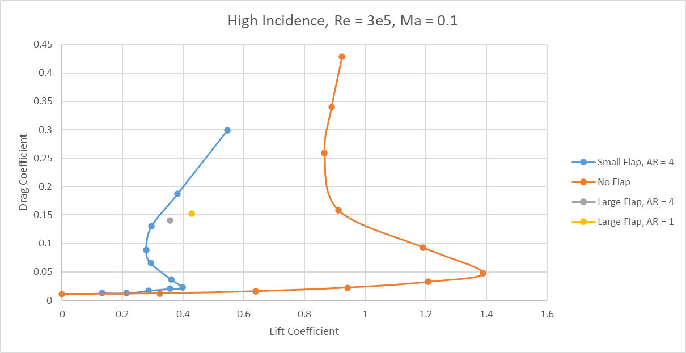
High Incidence - Maths
The extra drag generated by the flap hinders performance
Since in stall conditions lift is very small, no geometry can offset this effect: gurney flap is detrimental at high incidence
Aspect Ratio:
AR = h/l

